Slide 1

Context Manager & Collection Library
By-Aditya Ranjan Jha
20EE10006

Slide 2
Part A- Context Managers
>>Why do We need Context Manager ?
>>How do we implement context managers ?
>>what makes it a profitable choice?

Slide 3

>>Why Do we need context managers?
→in a public library books are issued and the records of the book issues are kept in a register Notebook. Now suppose in holidays the demand of novels increased and people issued novels for a week but did not return because the library does not charge any overdue fine[it’s a public library :)] and they could not return the book due to their hectic schedule or they misplaced the book or whatever so reason. Now if the number of defaulters who did not close their book issue accounts keeps on increasing the library system would slow down in issuing books due to lack of resources and ultimately it would collapse due to lack of books.
→ Visualize this example above as an analogy in programming
Books →Databases and file
Library → File Management

Slide 4

>>Why Do we need context managers?
→In any programming language, the usage of resources like file operations or database connections is very common. But these resources are limited in supply. Therefore, the main problem lies in making sure to release these resources after usage. If they are not released then it will lead to resource leakage and may cause the system to either slow down or crash. It would be very helpful if user have a mechanism for the automatic setup and teardown of resources
→With Python, it can be achieved by the usage of context managers which facilitate the proper handling of resources.

Slide 5
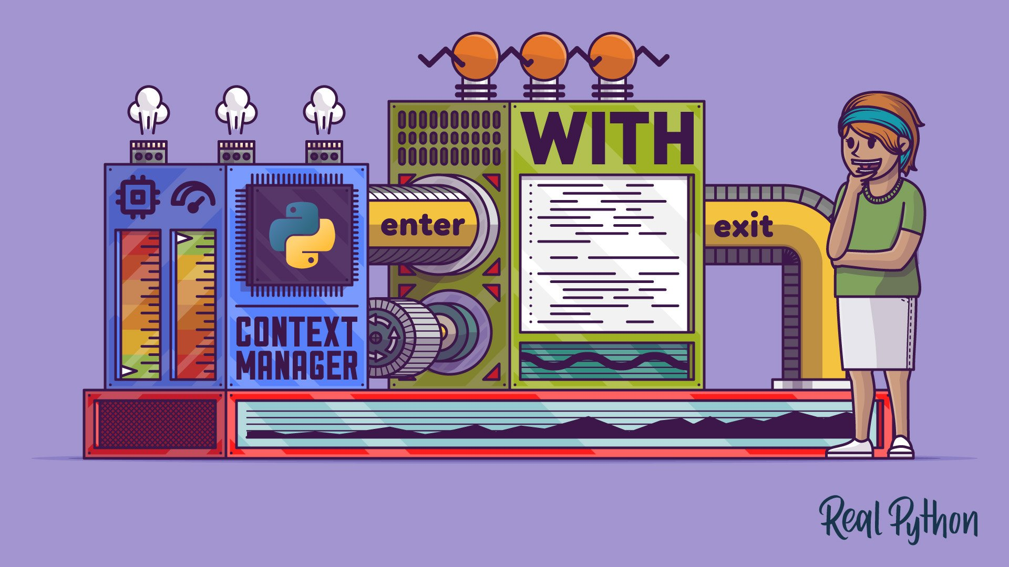
>>How do we implement context managers ?

Slide 6

>>How do we implement context managers ?
In python context managers can be created in two ways:
Using classes
Using generators and decorators

Slide 7
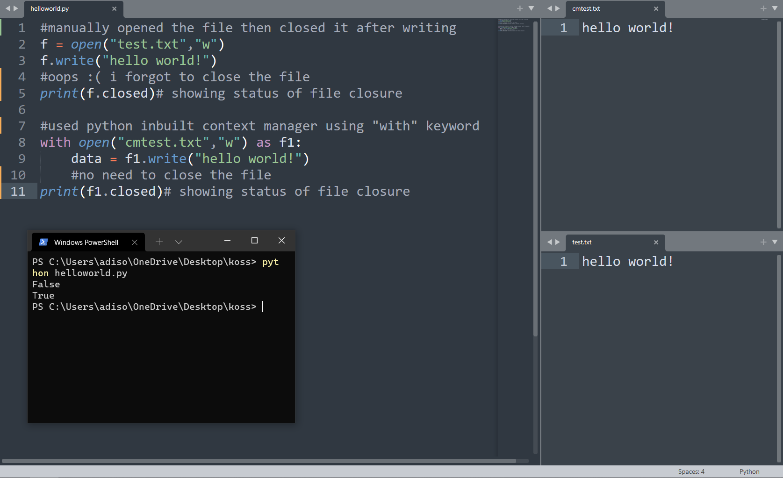
>>The hello world example!

Slide 8
>>Implementation: Using classes
→as we saw in the above hello world! code there is a inbuilt context manager for opening AND EDITING FILE AND THEN CLOSING THE FILE WHICH CAN BE IMPLEMENTED USING THE “WITH” KEYWORD .BUT WE CAN MAKE OUR OWN CONTEXT MANAGER USING 2 WAYS
→the first is with the help of classes
→ The user need to ensure that the class has the methods: __enter__() and __exit__().

Slide 9
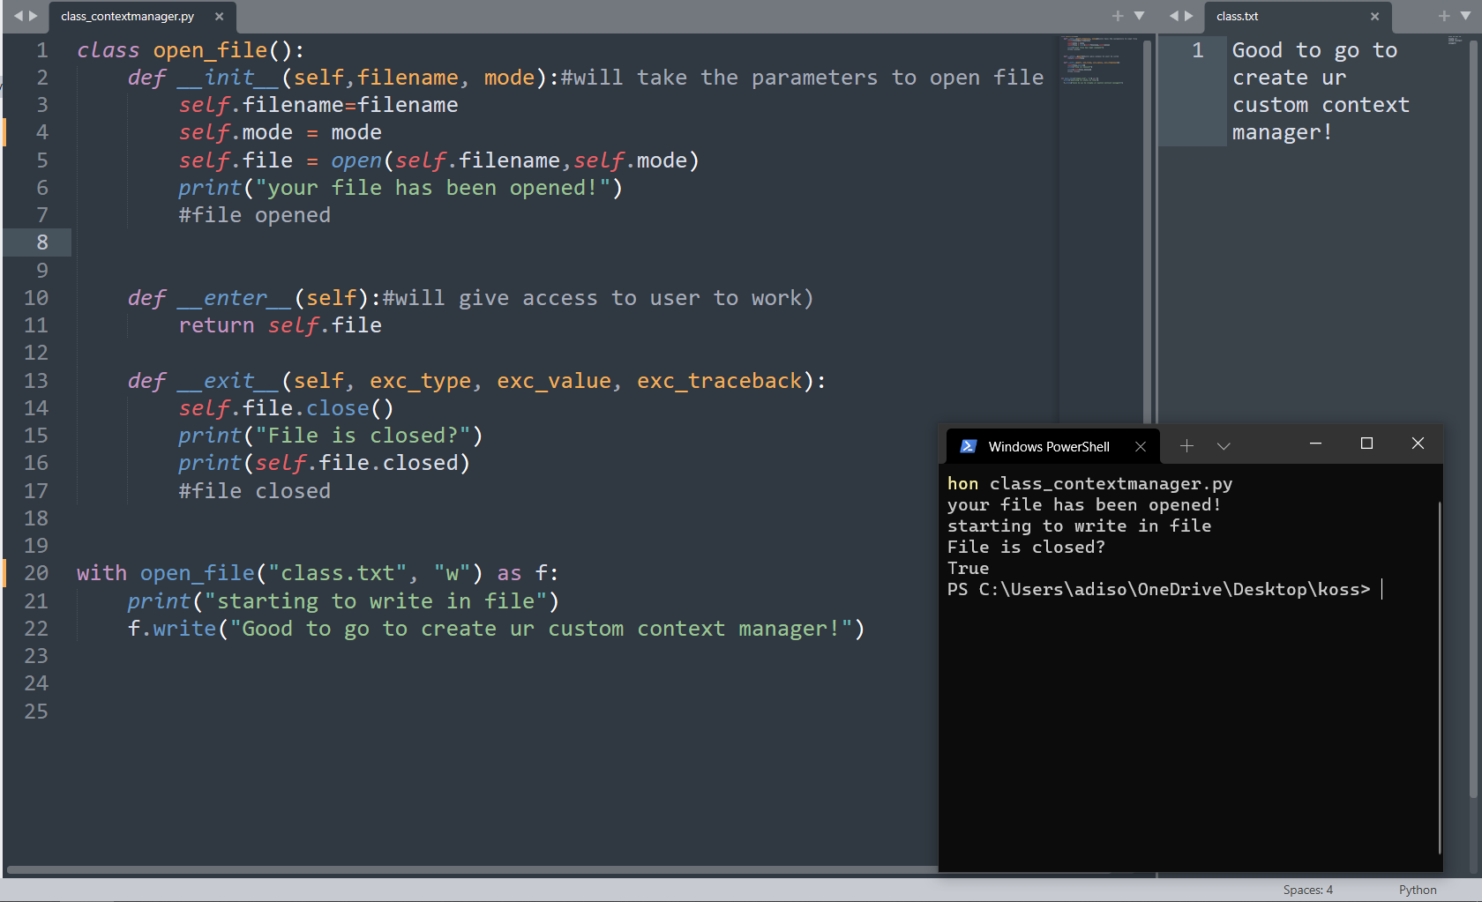
>>Implementation: Using classes

Slide 10

>>The picture below shows exactly the flow of execution

Slide 11
>>Implementation: Using generators
→ We can simply make any function as a context manager with the help of contextlib.contextmanager decorator without having to write a separate class or __enter__ and __exit__ functions.

Slide 12
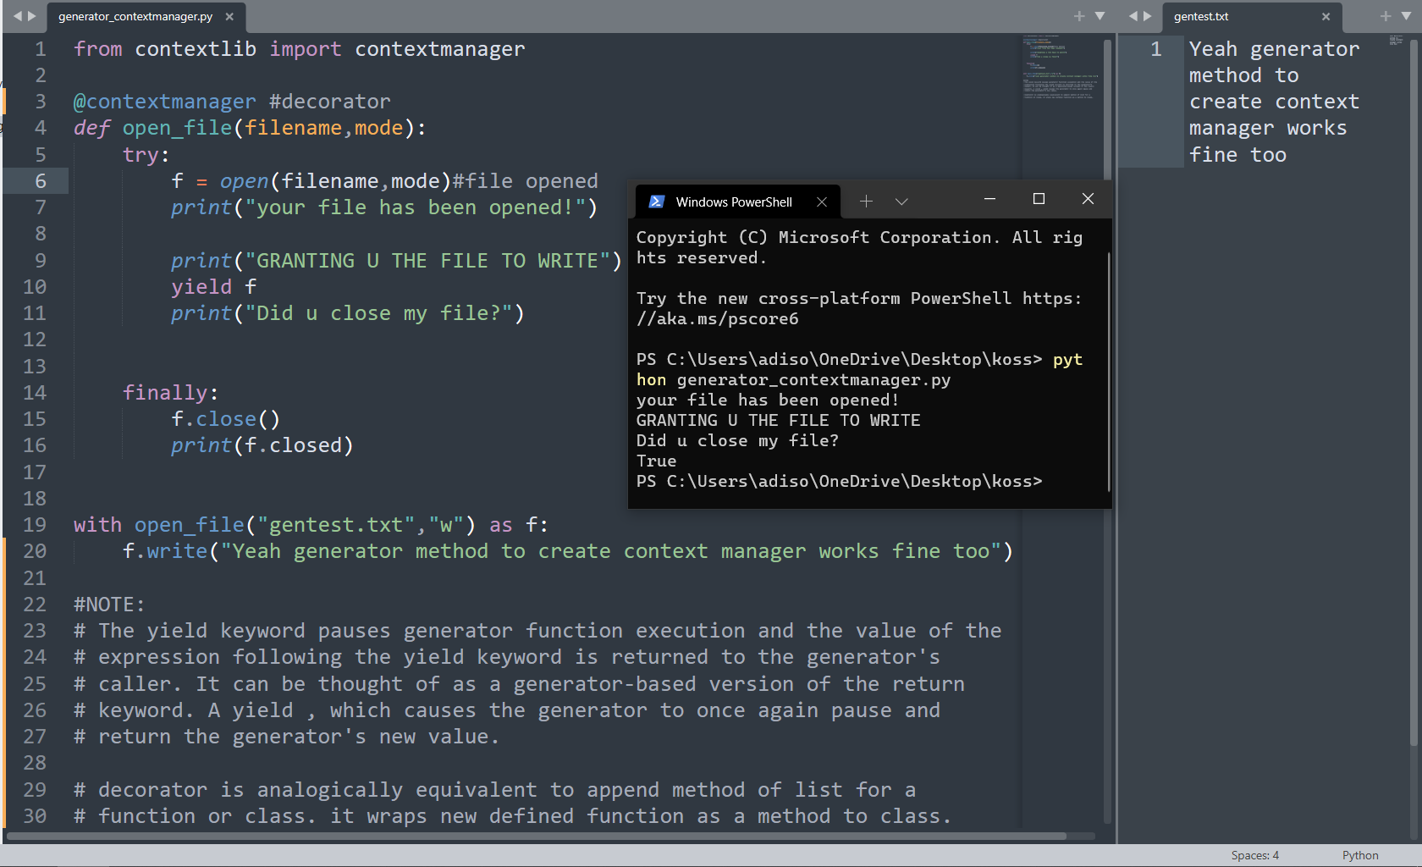
>>Implementation: Using generators

Slide 13
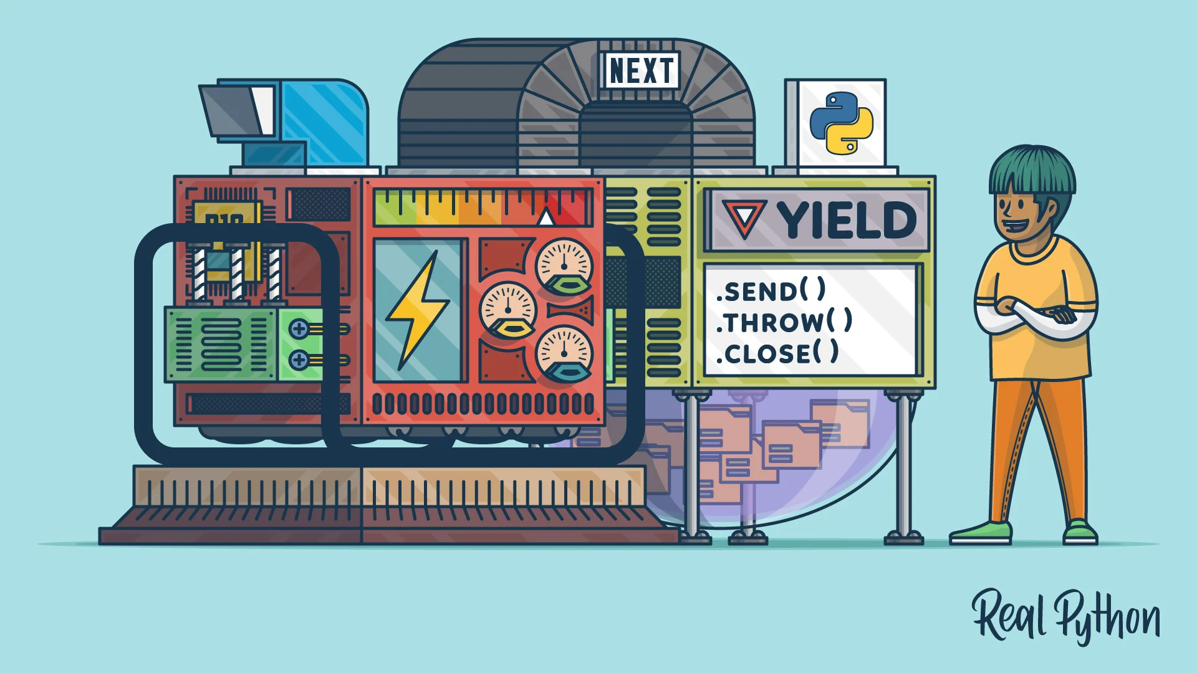
>>The picture below shows exactly the flow of execution for generator

Slide 14

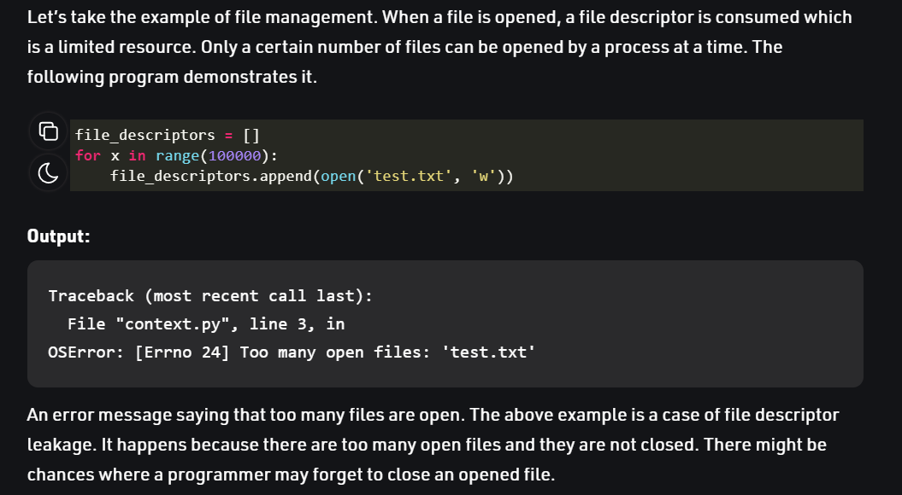
>>Context manager merits
→We have already seen during the implementation most of the benefits like file management and the files being closed even if there is some error while working in the file. What we have seen is about small scale database(files for us )but what happens when the no of files to be used are too large ?
→ So here is an example from geeksforgeeks.org

Slide 15
Part B- Collection libraries
>>introduction
>>Members of the collection libraries
>>How is it an upgrade from the inbuilt containers ?
>>Final Example(Task)

Slide 16

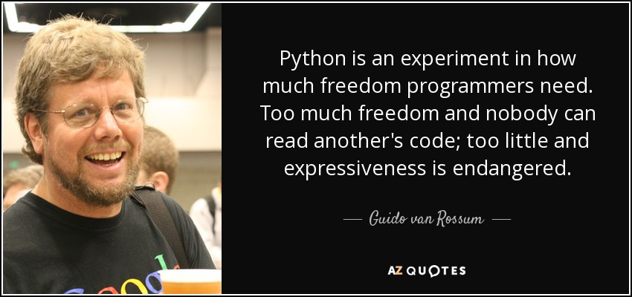
>>Introduction to collection library
→A Container is an object that is used to store different objects and provide a way to access the contained objects and iterate over them. Some of the built-in containers are Tuple, List, Dictionary, Set. Apart from this python also comes with a built-in module known as collections which has specialized data structures which basically covers for the shortcomings of the four data types and reduces your number of lines of extra code.

Slide 17
dictionary →Counter
→Dictionary in Python is an unordered collection of data values, used to store data values like a map, which unlike other Data Types that hold only single value as an element, Dictionary holds key:value pair in an unordered fashion.
→A counter is a sub-class of the dictionary. It is used to keep the count of the elements in an iterable in the form of an unordered dictionary where the key represents the element in the iterable and value represents the count of that element in the iterable.

Slide 18
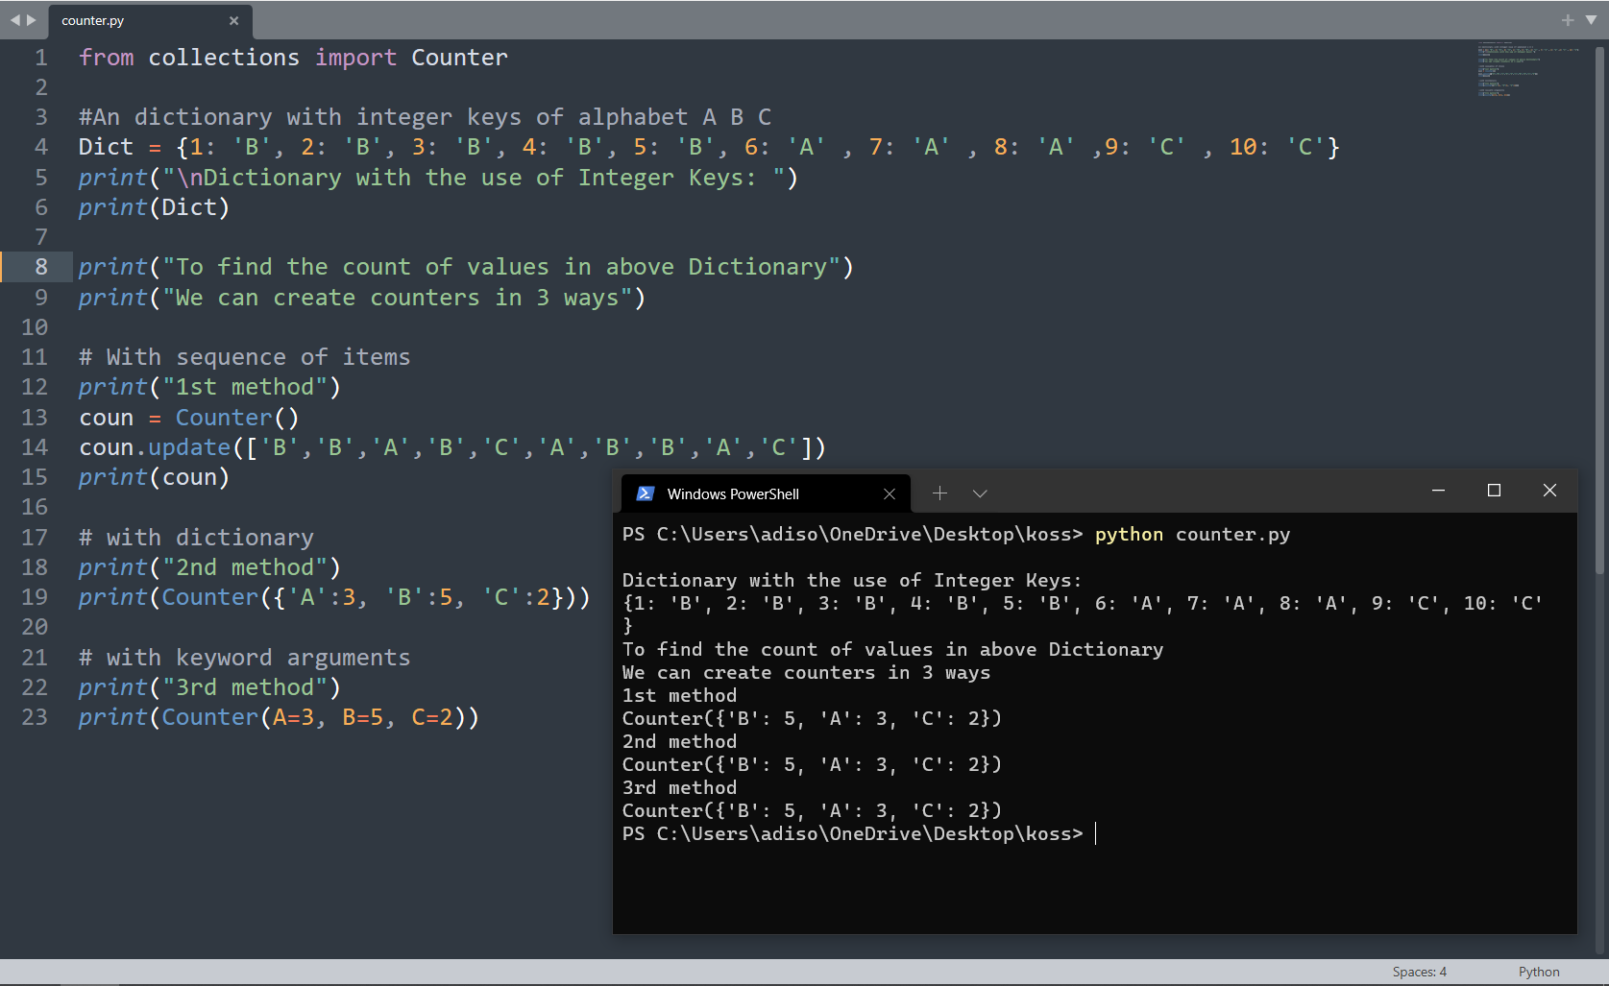
dictionary →Counter

Slide 19
dictionary →OrderedDict
→We know what a dictionary does (from previous slides)
→An OrderedDict is also a sub-class of dictionary but unlike dictionary, it remembers the order in which the keys were inserted. While deleting and re-inserting the same key will push the key to the last to maintain the order of insertion of the key.
→As of the latest version of python dictionary(default container) is also ordered

Slide 20
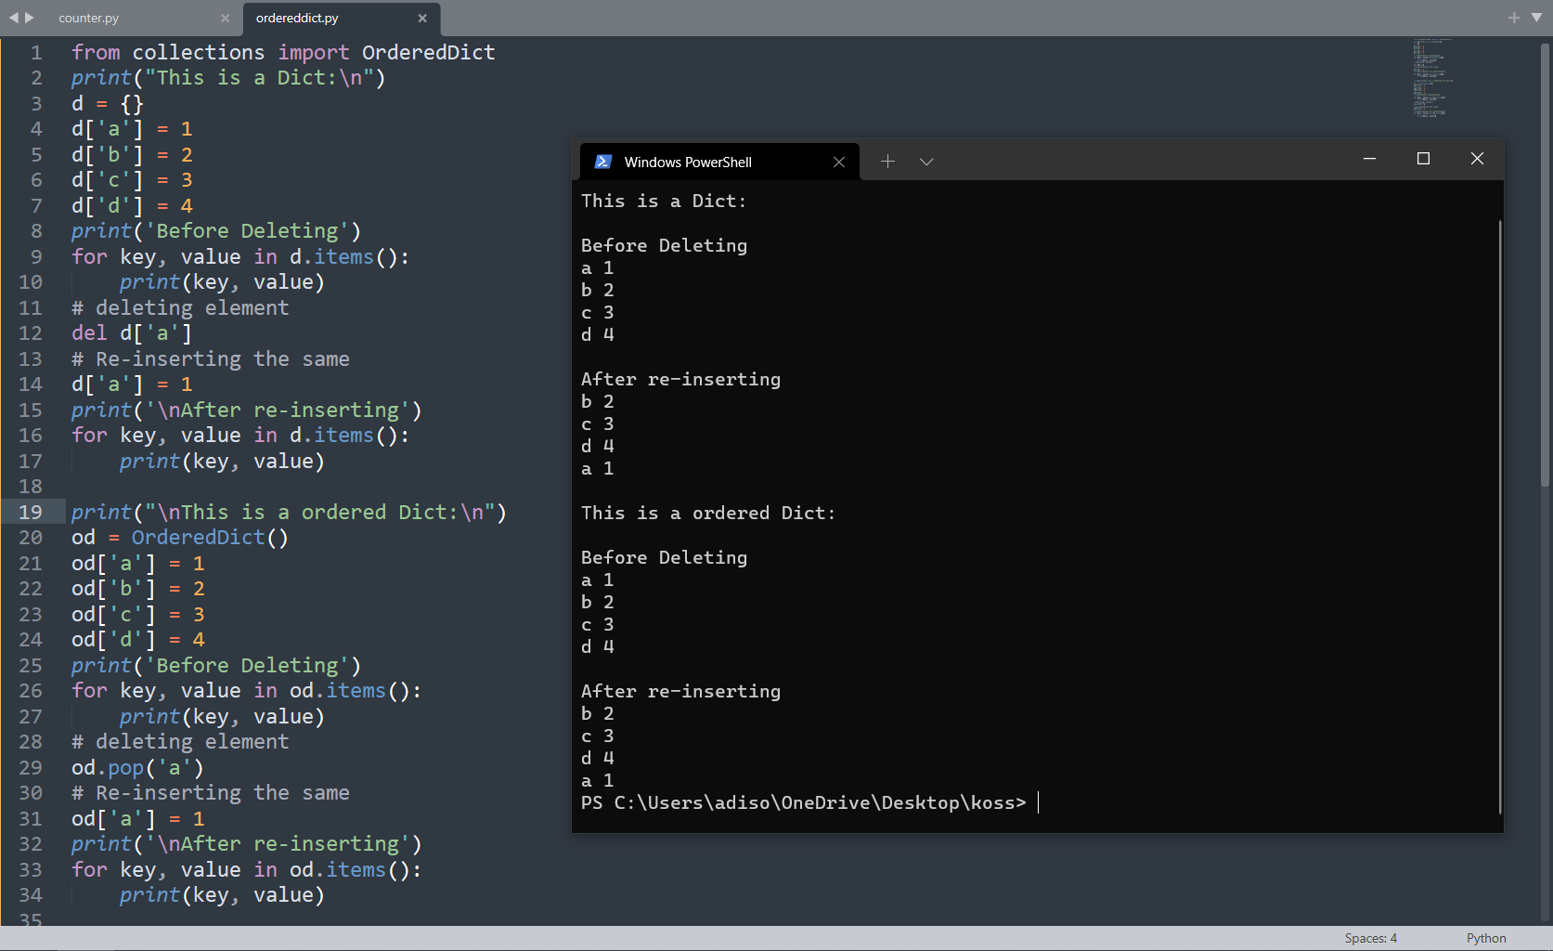
dictionary →Counter

Slide 21
dictionary →defaultdict
→ A DefaultDict is also a sub-class to dictionary. It is used to provide some default values for the key that does not exist and never raises a Key Error.

Slide 22
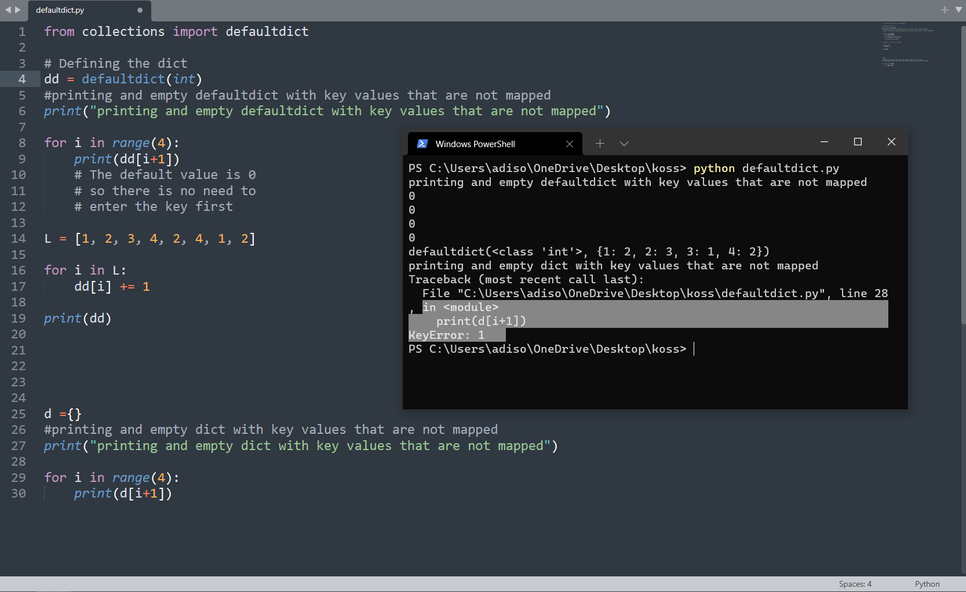
dictionary →defaultdict

Slide 23
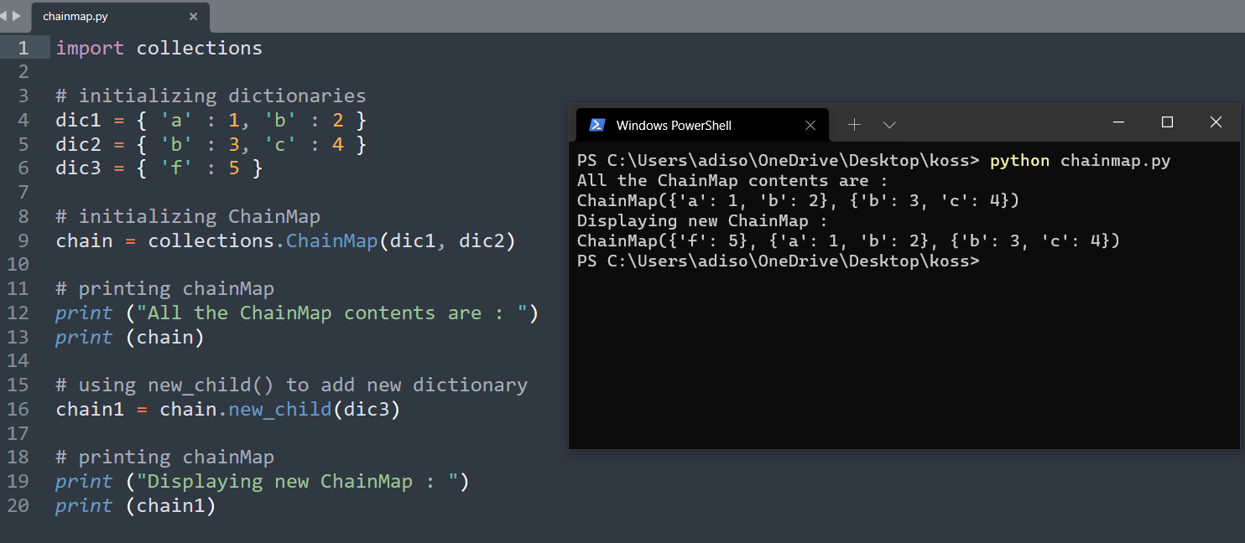
N X (dictionary ) →Chainmap
→A ChainMap encapsulates many dictionaries into a single unit and returns a list of dictionaries.

Slide 24
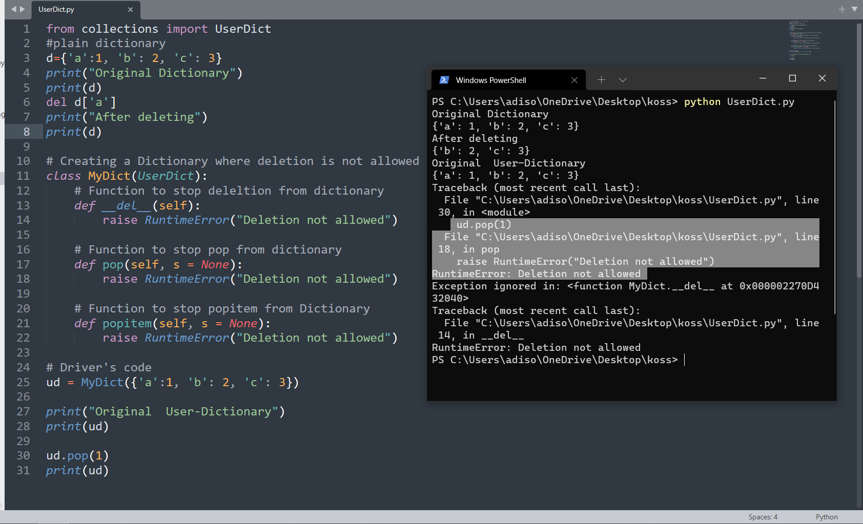
dictionary →USerdict
→UserDict is a dictionary-like container that acts as a wrapper around the dictionary objects. This container is used when someone wants to create their own dictionary with some modified or new functionality.

Slide 25
Tuples →namedtuple
→Tuple is a collection of Python objects much like a list. The sequence of values stored in a tuple can be of any type, and they are indexed by integers.
→A NamedTuple returns a tuple object with names for each position instead of indexes starting from zero, which the ordinary tuples lack.
→For example, consider a tuple names student where the first element represents fname, second represents lname and the third element represents the DOB. Suppose for calling fname instead of remembering the index position you can actually call the element by using the fname argument, then it will be really easy for accessing tuples element. This functionality is provided by the NamedTuple.

Slide 26
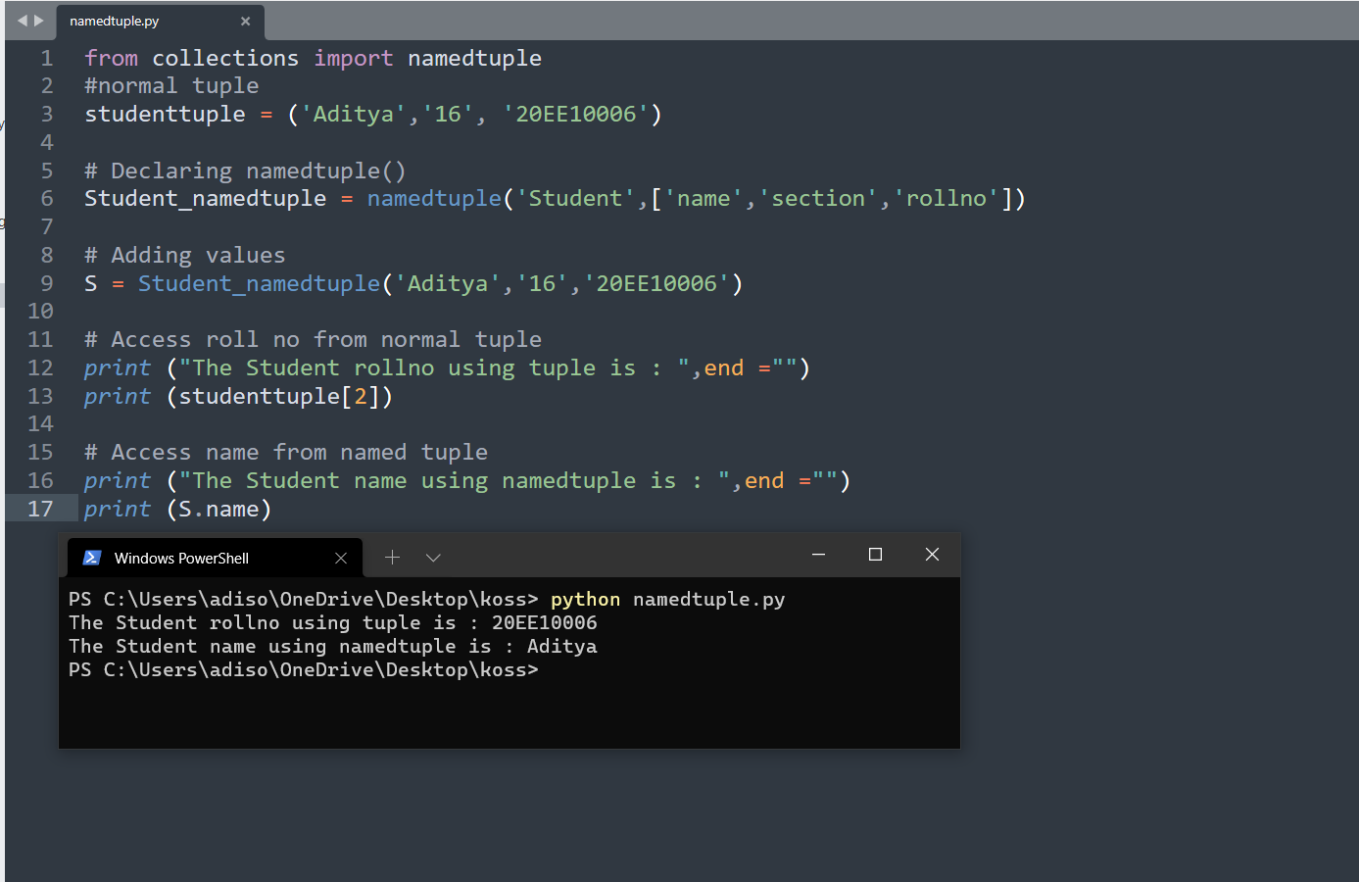
Tuples →namedtuple

Slide 27
List →Deque
→Lists are just like dynamic sized arrays, declared in other languages (vector in C++ and ArrayList in Java). Lists need not be homogeneous always which makes it a most powerful tool in Python. A single list may contain Datatypes like Integers, Strings, as well as Objects. Lists are mutable, and hence, they can be altered even after their creation. New elements can be appended at the end.
→Deque (Doubly Ended Queue) is the optimized list for quicker append and pop operations from both sides of the container. It provides O(1) time complexity for append and pop operations as compared to list with O(n) time complexity.

Slide 28
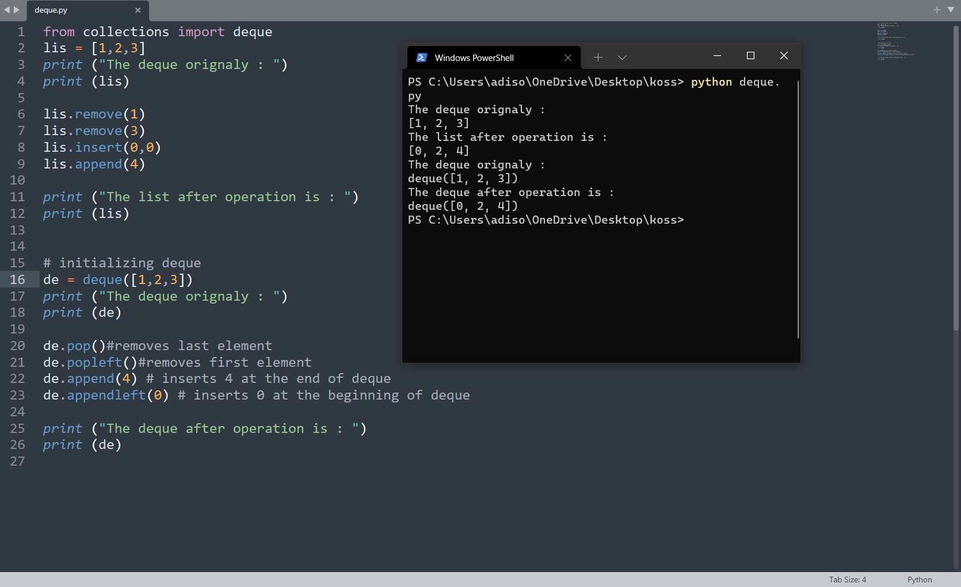
List →Deque

Slide 29
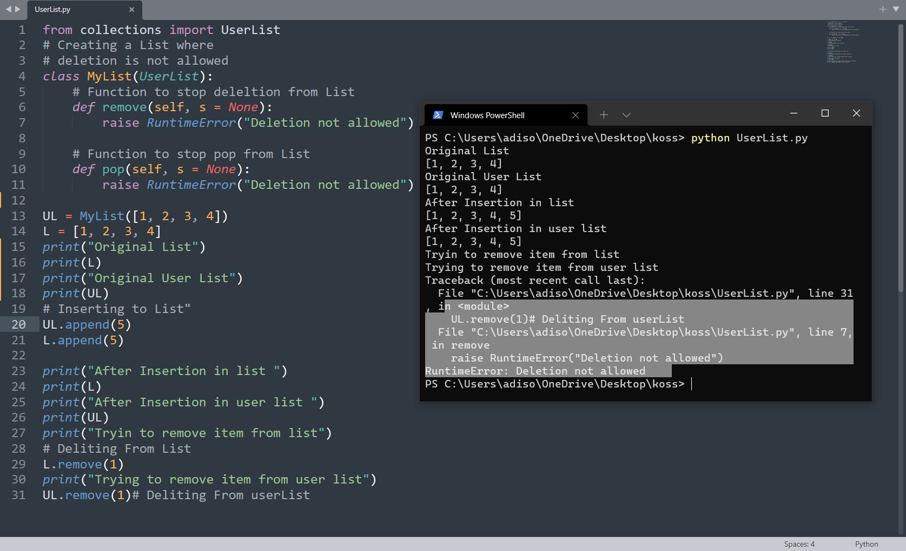
List →userlist
→UserList is a list like container that acts as a wrapper around the list objects. This is useful when someone wants to create their own list with some modified or additional functionality.

Slide 30
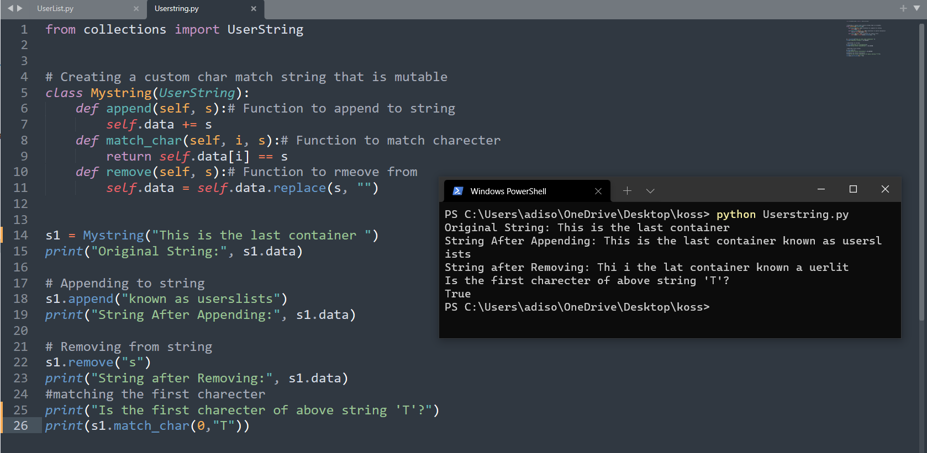
string →userstring
→Strings are the arrays of bytes representing Unicode characters.
→UserString is a string like container and just like UserDict and UserList it acts as a wrapper around string objects. It is used when someone wants to create their own strings with some modified or additional functionality.

Slide 31
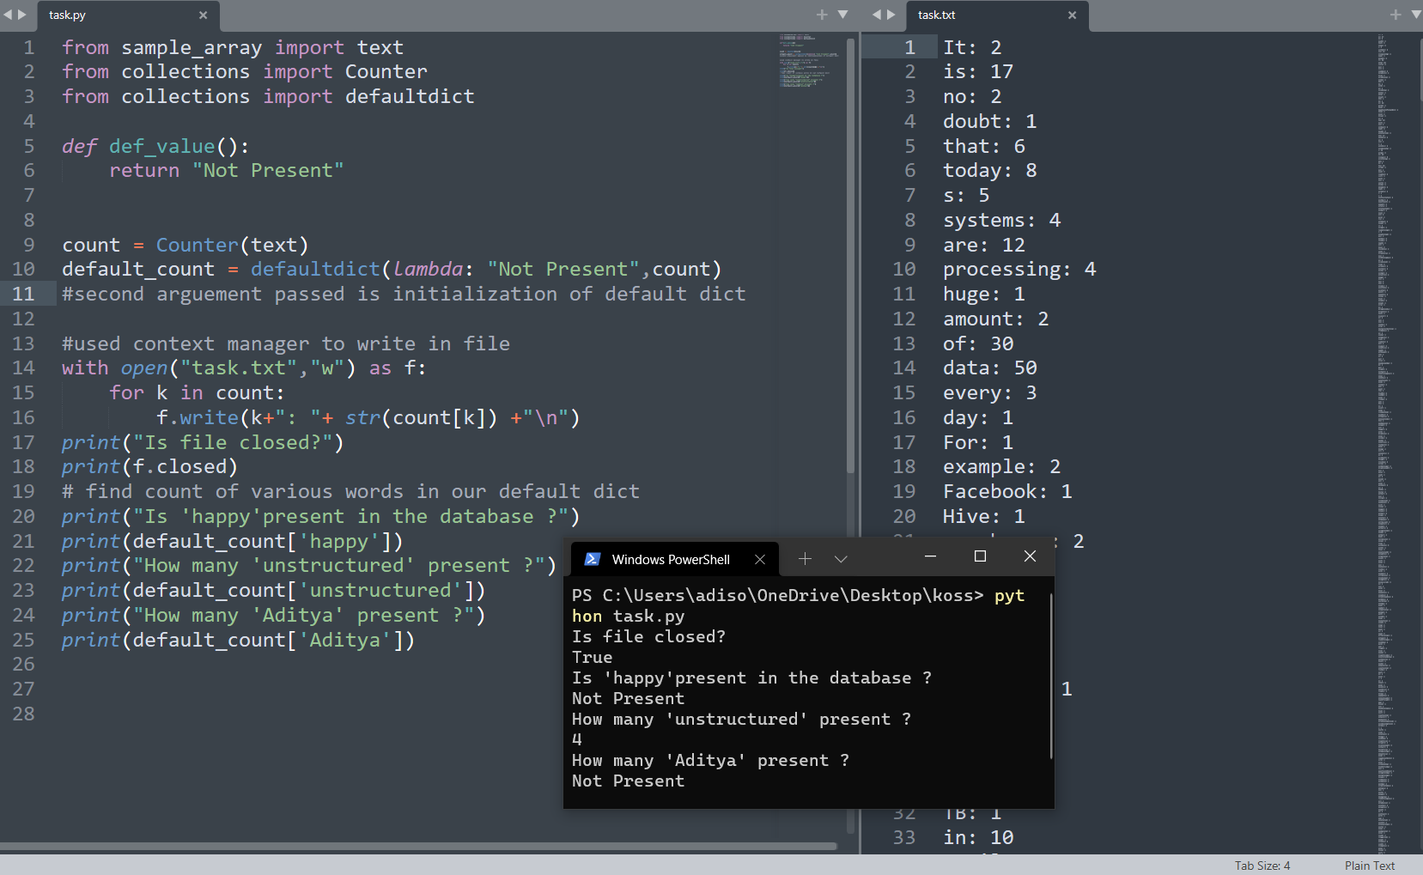
Final Example

Slide 32
thanks And Keep learning some important links
https://www.geeksforgeeks.org/python-collections-module/
https://docs.python.org/3/library/collections.html
https://www.geeksforgeeks.org/context-manager-in-python/
https://www.geeksforgeeks.org/context-manager-using-contextmanager-decorator/
https://book.pythontips.com/en/latest/context_managers.html
This presentation Git-hub Repository: github link

